Slide 1


RISING COSTS
BELLEVUE UNIVERSITY
Child care Burden
The Child Care Conundrum: Taking Action on the Child Care Burden
Presented by
Barath Anandaraman
Notes:
Hello Everyone, My name is Barath Anandaraman, and I'm a student in the MS in Data Science program at Bellevue University.
Today, we're going to dive into a critical issue that impacts every community across our nation:
'The Child Care Conundrum' and the urgent need for action regarding the burden of childcare costs.
This presentation will unpack the true scale of this challenge and its far-reaching consequences.

Slide 2



The Childcare Conundrum
Annual childcare costs have surged over 47% in 15 years, now surpassing $6,000 per child per year
This escalating expense is creating a national crisis, particularly for lower-income families and single earners
Single women are disproportionately affected, spending over 22% of their earnings on childcare compared to 14.9% for single men
The burden is uneven, with families in states like California, Washington, and Ohio spending over 20% of their annual income
It demands our immediate attention as a fundamental challenge to our families, our economy, and gender equity
2
Notes:
Let's start with some stark realities.
As you can see, childcare costs have exploded in the last 15 years, jumping by over 47% and now exceeding $6,000 per child annually.
This isn't just a number; it's a profound financial strain on families.
For lower-income households and single earners, this isn't just a burden, it's a full-blown national crisis.
We're seeing single women bear an exceptionally heavy load, spending over 22% of their income on childcare, significantly more than men.
And this isn't a uniform problem across the country; states like California, Washington, and Ohio are grappling with families spending over 20% of their income on childcare.
This isn't just a family issue; it’s a fundamental challenge to our economic stability, workforce participation, and gender equality.

Slide 3
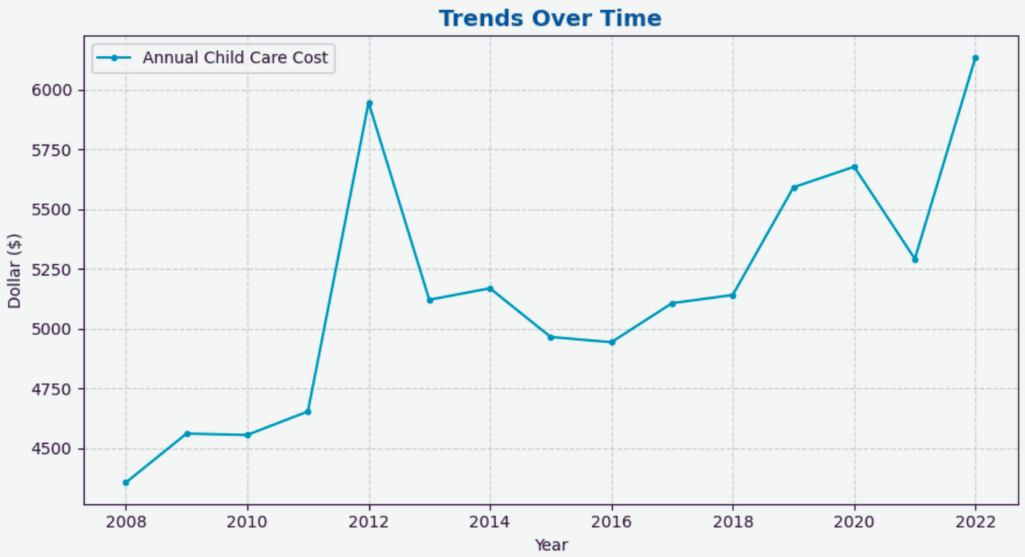



Childcare Cost Trends (2008-2022)
Gradual increase from $4,250 in 2008 to about $6,250 in 2022
Year 2012 is an outlier spiking close to $6,000. Reasons unknown at this point
About 47% increase on Childcare costs annually from 2008 to 2022
Trend show significant implications for families, affecting their budgets and financial well-being.
Outlier
3
Notes:
Now, let's look at the historical trend.
This chart clearly illustrates the steady rise in annual childcare costs from approximately $4,250 in 2008 to about $6,250 in 2022.
This represents a substantial 47% increase over this period.
You'll notice a distinct spike around 2012, where costs briefly touched close to $6,000.
The exact reasons for this specific outlier are not fully clear from our current data, but the overall trend unmistakably points to a significant and growing financial strain on families' budgets and financial well-being.
This upward trajectory continues to have serious implications for household economics

Slide 4
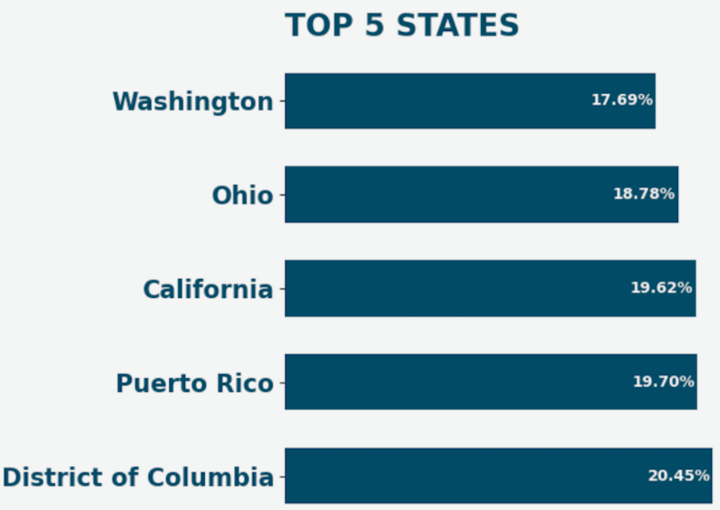
Burden by States
Childcare costs are not uniform - some states are facing significantly higher burdens
Families in Washington and Ohio spend 18-19% of their annual income towards childcare per child
District of Columbia, Puerto Rico, and California lead with burdens exceeding 19% of annual income
These percentages far surpass the federal affordability threshold of 7%, signaling a crisis
4
Child care is considered affordable if it costs no more than 7% of family income - Source: U.S. Department of Health and Human Services (HHS)
Notes:
Moving from temporal trends to geographical disparities, we see that the burden of childcare costs is far from uniform across the nation.
This map highlights states where families are facing an extreme financial squeeze.
For instance, in Washington and Ohio, families are dedicating between 18-19% of their annual income to childcare per child.
But the situation is even more dire in places like the District of Columbia, Puerto Rico, and California, where the burden exceeds 19% of annual income.
To put this into perspective, the federal government's affordability threshold for childcare is set at 7% of income.
These states are spending more than double, sometimes nearly triple, that benchmark, indicating a severe affordability crisis in these regions.
It's clear that geographic location plays a huge role in the financial viability of raising a family.

Slide 5
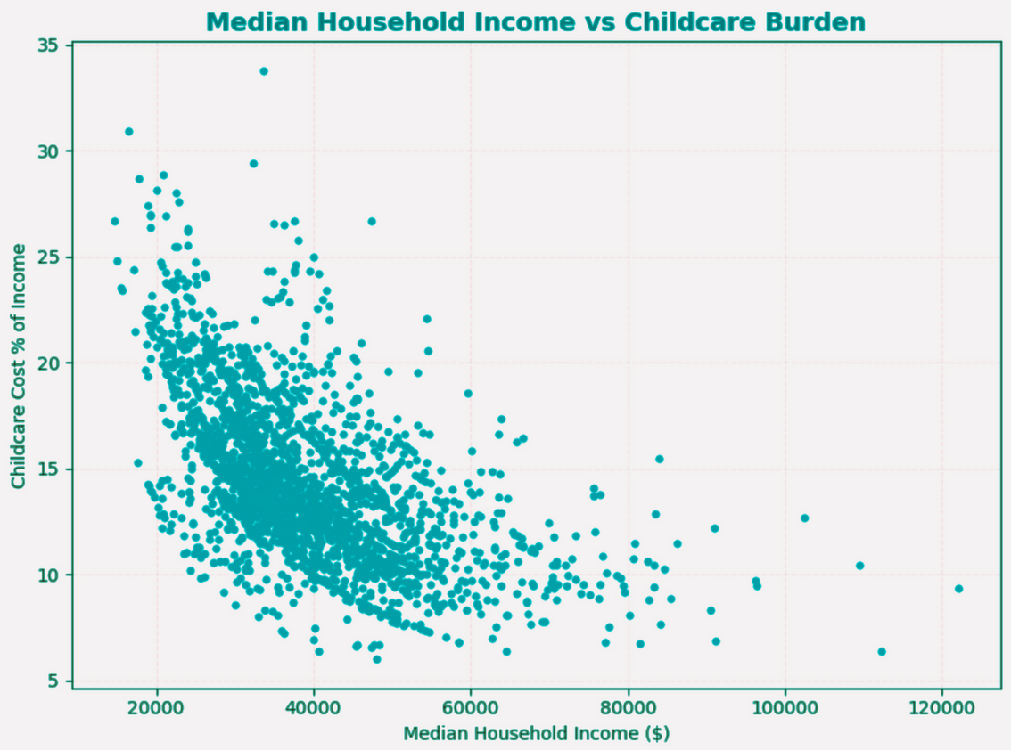
Burden by Income
Low burden on high income families
High burden on low-income families, Households earning between $20,000 and $40,000 may spend a very large chunk of their income on childcare
Negative correlation - Income to Child care burden (As high as 30% on some low-income households)
Trend show significant implications for families in low-income categories.
5
Notes:
Beyond geography, the burden of childcare is profoundly shaped by income level.
As this chart illustrates, there's a clear negative correlation: as income rises, the percentage of income spent on childcare significantly decreases.
High-income families experience a relatively low burden.
However, for low-income families, the picture is dramatically different.
Households earning between $20,000 and $40,000 may find themselves spending an extraordinarily large portion of their income on childcare – in some cases, as high as 30%.
This is not just a financial strain; it's a barrier to economic mobility and can push families deeper into poverty.
The trend clearly highlights that childcare costs disproportionately impact and exacerbate financial instability for those already struggling the most.

Slide 6
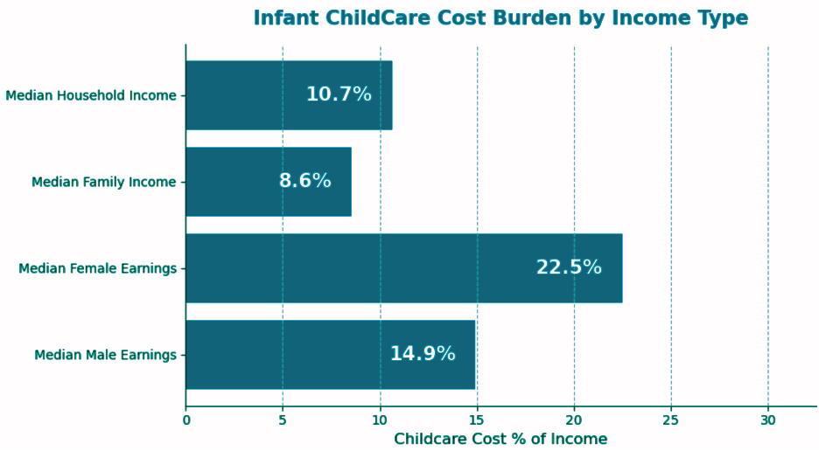
Burden by Gender and Income Type
Single Female has to spend 22.5% of earnings on Childcare cost
Single Male has to spend 14.9% of earnings on Childcare cost
Households spend 10.7% of earnings on Childcare cost
Disparity can have major implications for workforce participation
6
Notes:
Further dissecting the demographic impact, we see a striking disparity when we look at gender.
For single females, the financial burden of childcare is particularly severe, with an average of 22.5% of their earnings going towards childcare costs.
This is significantly higher than the 14.9% spent by single males. This gap is not just a statistic; it underscores a profound gender equity issue.
The disproportionate financial strain on women can influence career choices, restrict professional advancement, and hinder economic well-being, reinforcing existing inequalities in the workplace.
It's a critical factor contributing to why many women may feel forced out of the workforce or into part-time roles

Slide 7
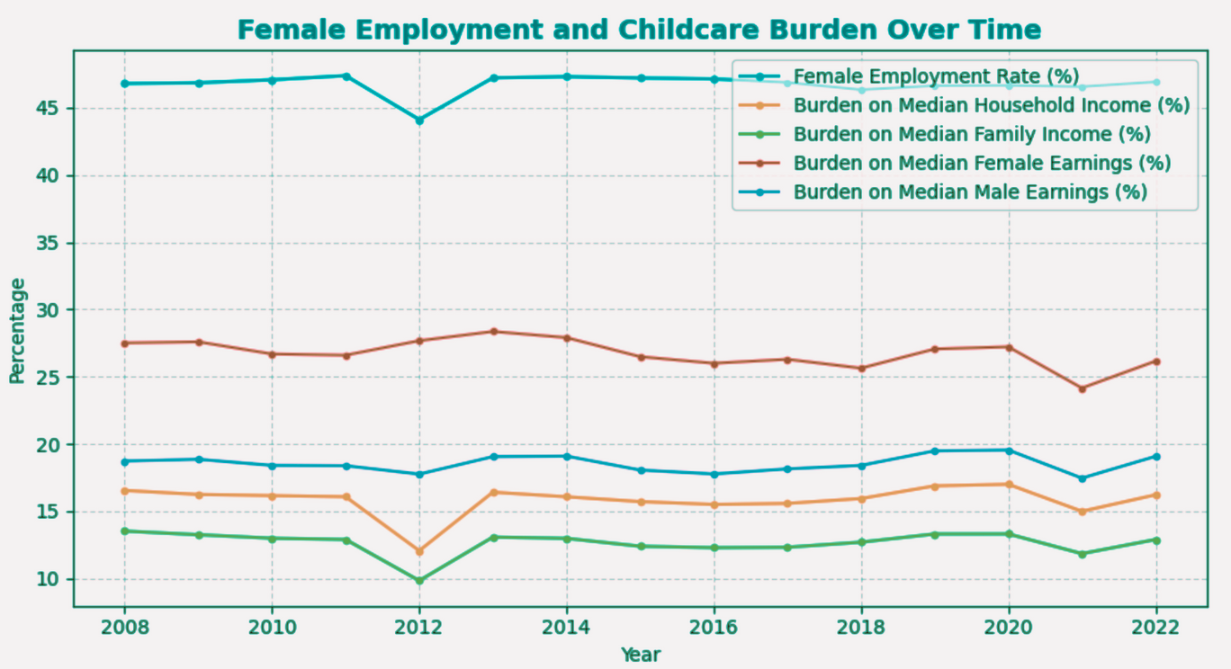
Burden and Employment Patterns
2012 outlier seems to have impacted employment on Single Female
Single Female still are highest impacted with the Childcare cost increase
Consistent disparity in the childcare burden across different income measures
Impact across all the types of income measures are fairly stable.
7
Notes:
This next visual connects two important trends: female employment rates and the ongoing childcare burden.
While we've observed a relative stability in female employment rates over time, the persistent and growing financial burden of childcare remains a significant underlying factor.
This heavy cost can subtly, yet powerfully, influence women's career decisions – whether to return to work full-time, pursue promotions, or even stay in the workforce at all. It impacts their overall economic well-being and contribution to the economy.
This slide emphasizes that even with stable employment, the cost of care can be a silent force limiting potential and perpetuating financial stress for working mothers

Slide 8

Summary
1
Childcare costs place a disproportionately heavy burden on lower-income families and individuals, especially women.
2
The cost of childcare has been steadily rising over the past decade, adding to the financial strain on households.
3
While female employment rates have remained relatively stable, the financial burden of childcare continues to be a significant factor, potentially impacting career choices and economic well-being.
These trends have far-reaching consequences, affecting not only individual families but also the broader economy. When parents, particularly mothers, are forced to make difficult choices between work and childcare, it can lead to:
Reduced workforce participation
Lower productivity
Increased economic inequality
8
Notes:
To summarize our findings, three key points stand out: ‘
First, childcare costs disproportionately burden lower-income families and individuals, with women bearing an especially heavy load.
Second, this isn't a fleeting problem; the cost of childcare has been steadily rising for over a decade, intensifying financial strain on households nationwide.
And third, despite stable female employment rates, the financial weight of childcare remains a critical barrier, influencing career decisions and economic security for countless women.
These trends are not isolated issues; they have far-reaching consequences that impact our entire economy.
When parents, particularly mothers, are forced to make difficult choices between work and childcare, it inevitably leads to reduced workforce participation, lower overall productivity, and unfortunately, increased economic inequality across society

Slide 9

Call To Action
1
Support policies that make childcare more affordable
This could include increased government subsidies, tax credits for families, or caps on childcare costs
2
Promote workplace flexibility
Encourage employers to adopt policies that support working parents, such as flexible hours, remote work options, and on-site childcare facilities.
3
Raise Awareness
Continue to educate policymakers, businesses, and the public about the true cost of childcare and its impact on families and the economy
4
Advocate For Systemic Change
We need to work together to create a system that values caregiving and ensures that all families have access to affordable, quality childcare
9
Notes:
he good news is that we have clear avenues for action.
To address this crisis, we must collectively pursue four key strategies:
First, we need strong policy support to make childcare more affordable.
This means advocating for increased government subsidies, expanding tax credits for families, or even implementing caps on childcare costs to bring them within reach.
Second, we must promote greater workplace flexibility.
Employers have a crucial role to play by adopting policies that genuinely support working parents, such as flexible hours, remote work options, and where feasible, on-site childcare facilities.
Third, we must advocate for systemic change.
This isn't just about individual policies; it's about fundamentally reshaping our approach to caregiving, ensuring that it is valued and that all families, regardless of income or location, have access to high-quality, affordable childcare.
And finally, we must continue to raise awareness.
We need to educate policymakers, businesses, and the broader public about the true economic and social cost of inadequate childcare and its far-reaching impact on our families and our economy.

Slide 10
Let’s Act Now
Childcare burden is a growing crisis that touches every part of our economy
We have the data, we see the trends - now is the time for action
Support policies, promote workplace change, and advocate for affordable childcare
Together, we can build a future where every family thrives
10
Notes:
In conclusion, the childcare burden is not an abstract problem; it is a growing crisis that profoundly impacts every part of our economy and society.
We have analyzed the data, we have seen the alarming trends, and the message is clear: now is the unequivocal time for action.
Let us commit to supporting policies that bring affordability within reach, promoting workplace changes that empower working parents, and advocating tirelessly for accessible, quality childcare.
By working together, with a shared vision and collective effort, we can build a future where every family has the opportunity not just to survive, but to truly thrive. Thank you.

